Slide 1

Track IT Enterprise Level Application

Slide 2
Submitted by:-
NAME | ROLL NO. | BRANCH | SAP ID
Mehak Gagneja | R163217004 | CSE MC | 500061469
Aishwarya Ubhrani | R163217014 | CSE MC | 500063738
Vinayak Sharma | R163217015 | CSE MC | 500063128
Under The guidance of :-
Dr. Durgansh Sharma

Slide 3

Problem Statement
Problem statement:-
These days’ people are fully dependent upon their mobile phones. everything is available on the internet, everything can be accessed with just a click. so why not consignments or orders. Heavy consignments which take days to reach the destination are often ignored. there are thefts with such orders on the journey that take place. Such consignments authenticity is checked through their weight and physical appearance(wear and tear).

Slide 4
A sneak peak of the Application
Introduction/Objective
The Enterprise Application suggested is a Business to Business Application, named Track IT. It’ll be a native Android Application.
It is basically a tracking service application at an enterprise level.
It is a Business to Business application.
Companies can track their consignments by using this particular application.
The location can be tracked to check where the consignment has reached.
The Company staff will be notified via push notifications at various steps, such as shipment.
Abstract
Our customized apps increase the turnaround and capacity of merchandise.
They manage activities like transportation management, inventory management, order management and
fleet management. It also facilitates the consolidation of air, water and ground shipments.
This project attempts to develop a application name Track It for android applications through which user
can acquire details about their respective consignments or orders.

Slide 5
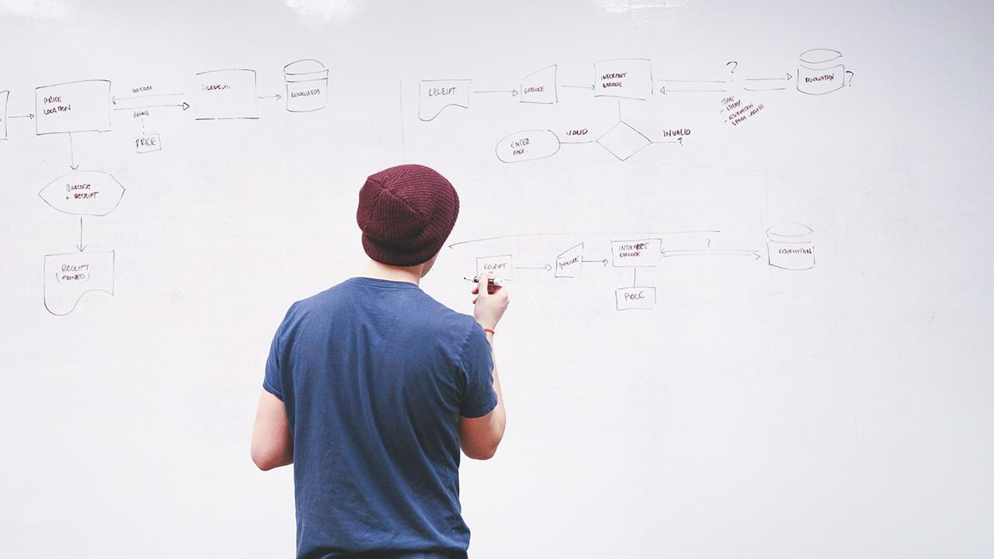
Features of the application
Authentication
QR Code Scanner
Location Tracker
Push Notifications
Complaint service
Google Maps Implementation
Database storage and retrieval

Slide 6
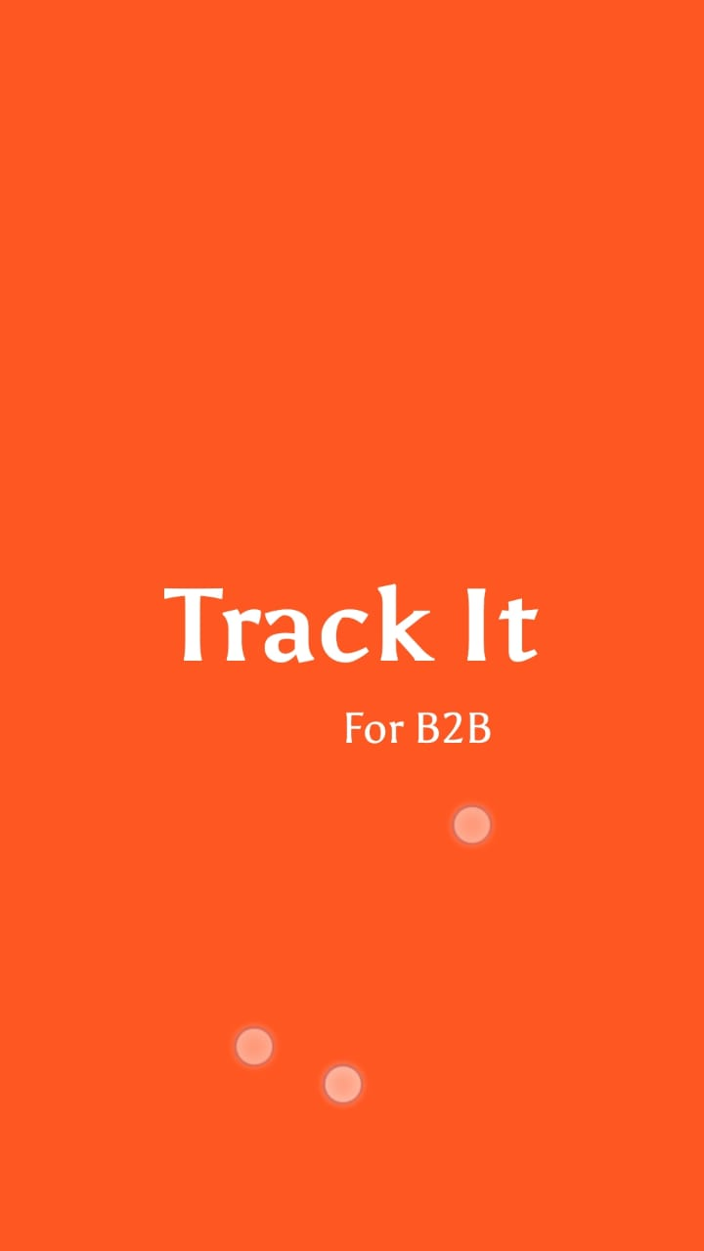
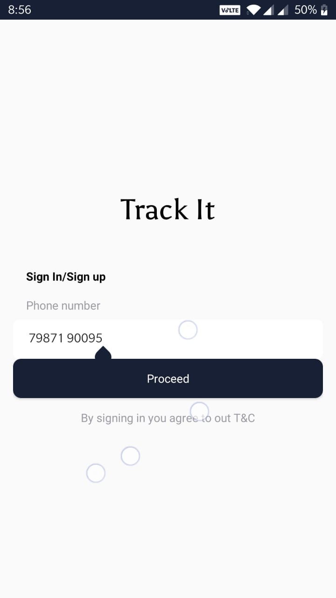
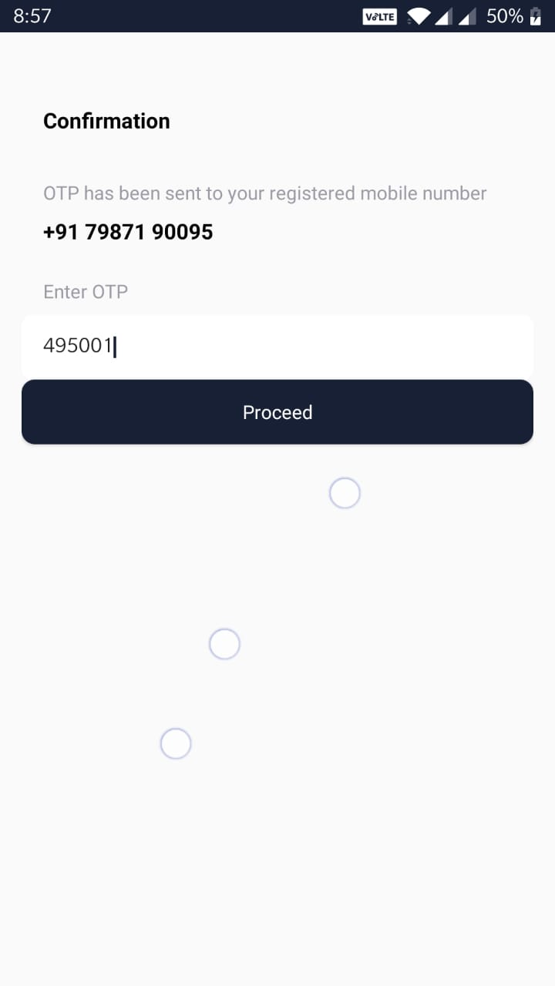
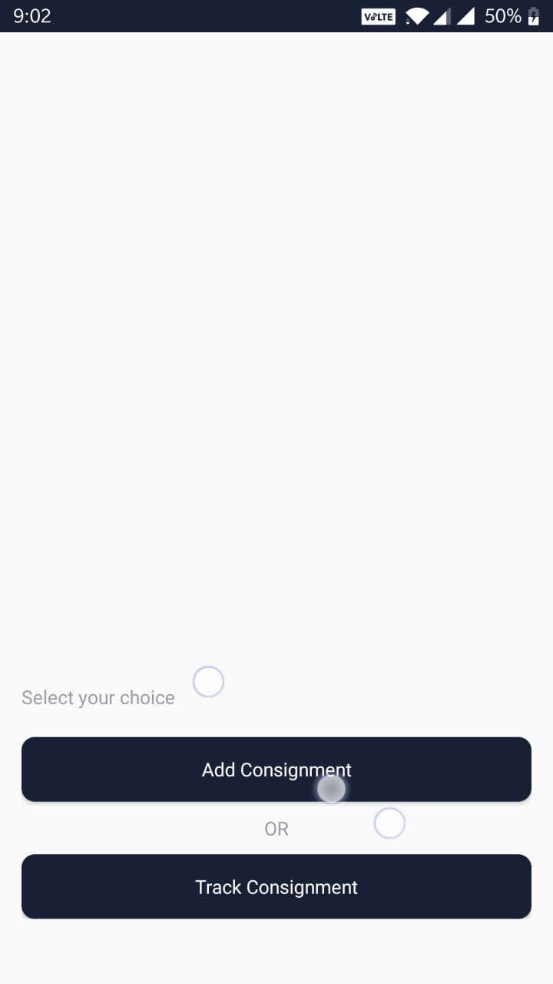
Screenshots
Contd.

Slide 7
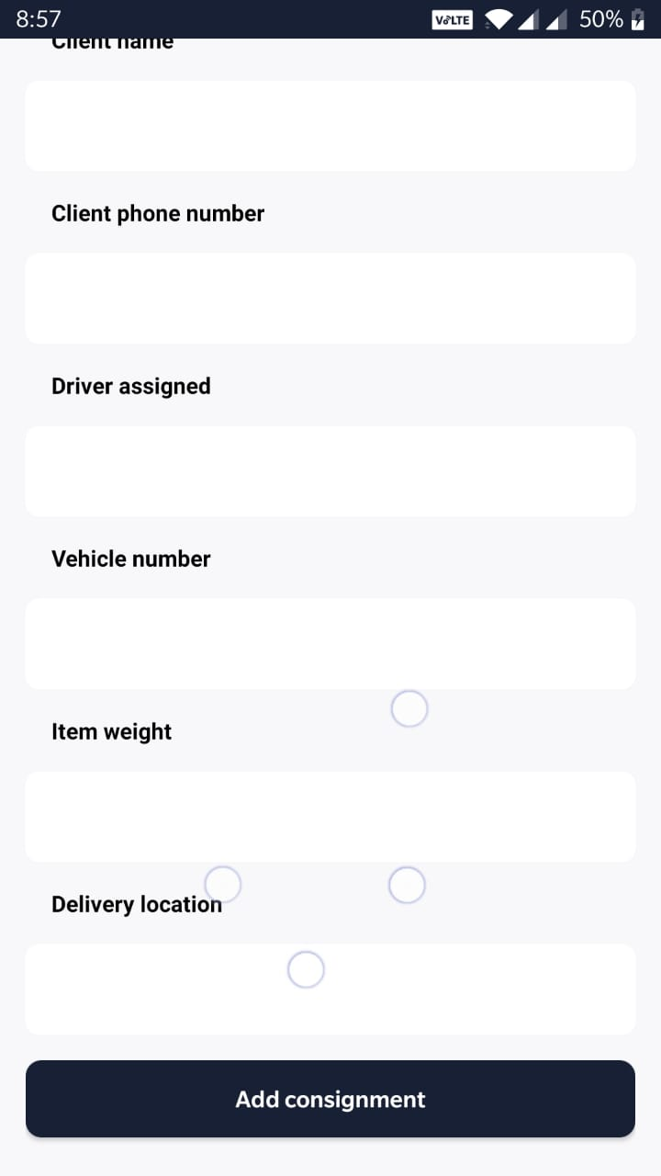
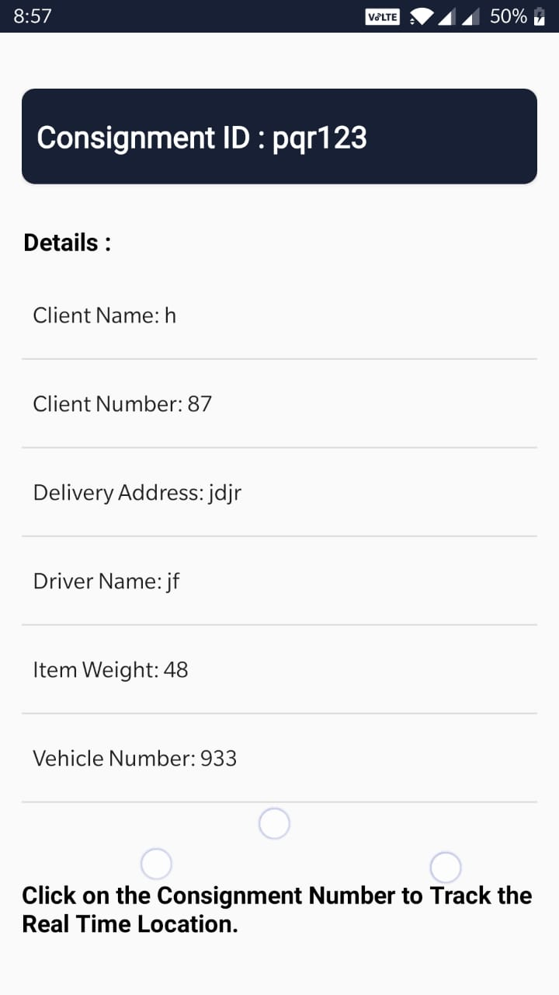
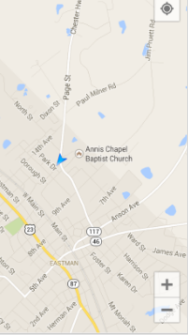
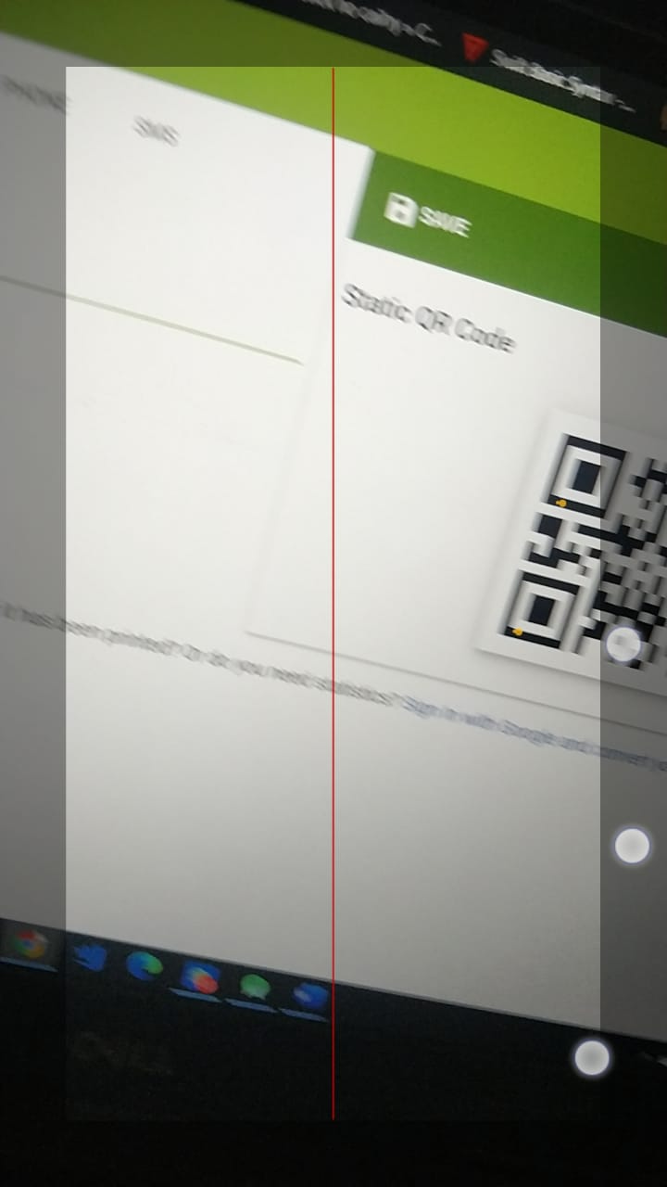
Screenshots

Slide 8
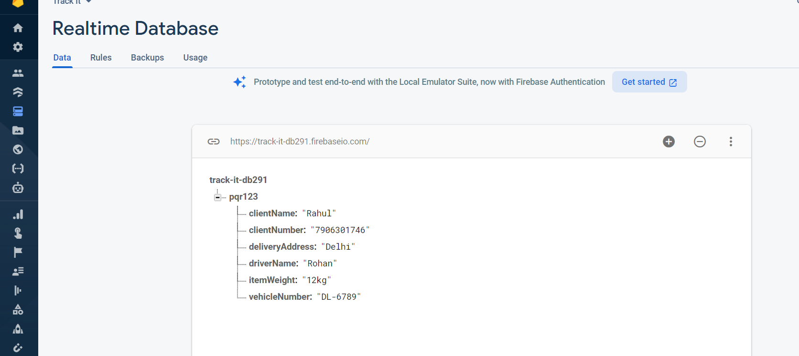
Real-Time Database

Slide 9
Screen1 It is a splash screen with the logo of the Application, which will be displayed for a few seconds.
Screen2 The next screen will be taking some input from the user i.e. his/her phone number for authentication. It is an OTP based authentication; the user will receive an OTP to log into his/her account. Here, the user enters his/her phone number and clicks proceed to jump to the next screen.
Screen3 Now, the received OTP is entered by the user, to log in successfully. In case, he/she fills the wrong OTP, access will not be granted.
Screen4 In this particular screen, the user has the option to enter either the consignment number or the reference number with him/her to proceed and check out the status.
Screen5 This is the main screen of the application. Here, the reference number or the consignment number along with the orderID is displayed to the user. Along with that, the user is displayed all the details of the consignment, such as, weight, driver’s phone number, vehicle number and all the further necessary details. Moreover, if the user wishes to track the consignment, he/she can do it by clicking the ‘CLICK HERE to access the real time location of your order’ , by which the user will be taken to Screen 6 of the application. The user can log out whenever he/she wishes to. However, if the user does not log out, he/she is be directed to the main screen i.e. Screen 5 only, there is no need to authenticate oneself again.
Screen6 This is the screen where the user can actually track the consignment on Google Maps and locate it as and when required, i.e. according to his/her convenience.

Slide 10
Motivation
The new research, conducted by the University of Oxford and published in leading journal Science, shows the virus is spreading too quickly for the pandemic to be contained by simply isolating those we know are infected or by manually tracing all their contacts. The location-tracking aspect of the app could be enhanced by enabling users to check in to locations such as shops, public transport stations or workplaces. To encourage more people to use the app, it could also provide access to health services, information and even food or medicine deliveries during self-isolation. The researchers also said that the app should be combined with other measures such as social distancing and frequent hand washing.

Slide 11
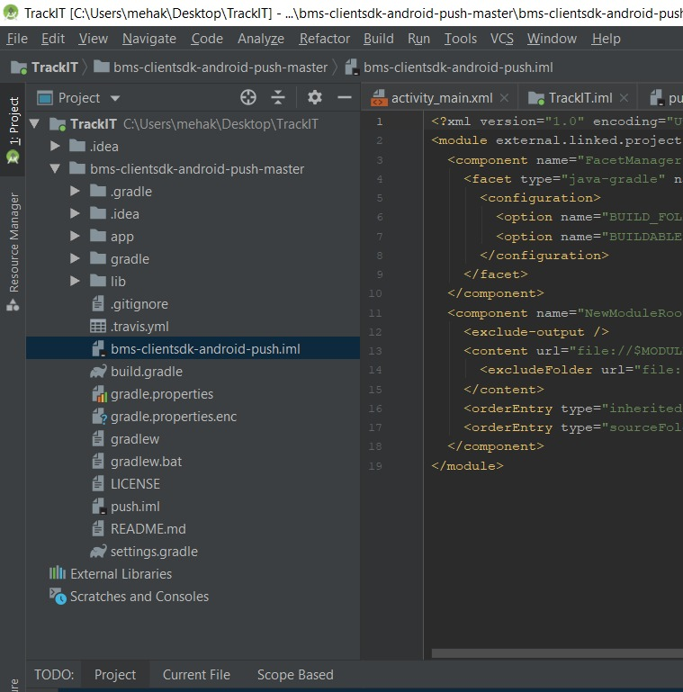
Push Notifications
A push notification is a message that pops up on a mobile device. App publishers can send them at any time; users don't have to be in the app or using their devices to receive them. ... Push notifications look like SMS text messages and mobile alerts, but they only reach users who have installed your app.

Slide 12
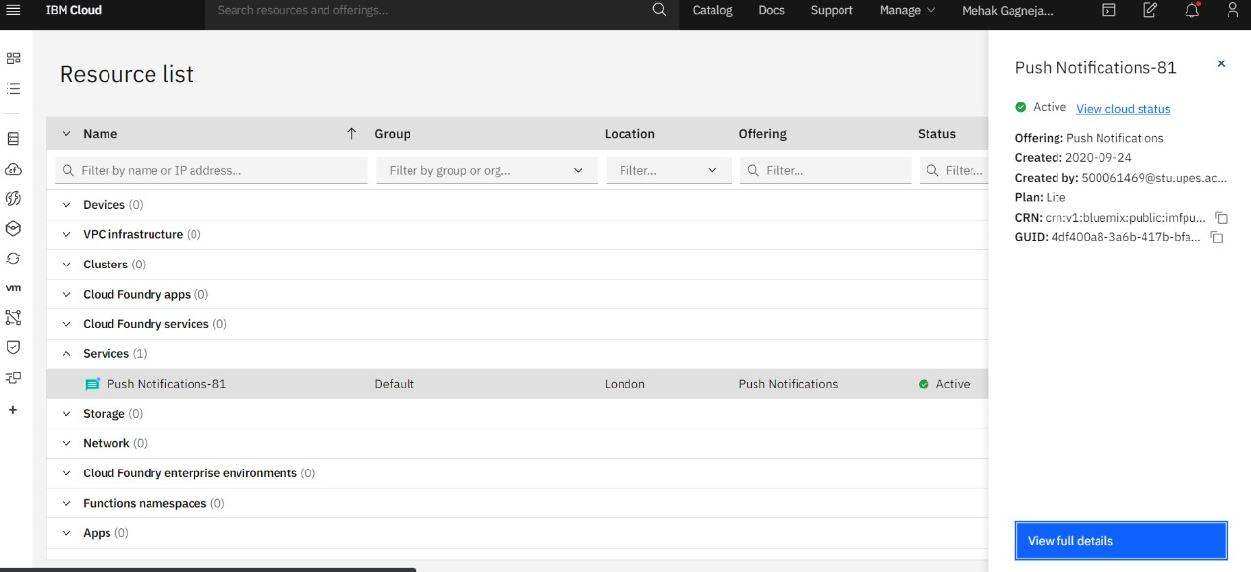
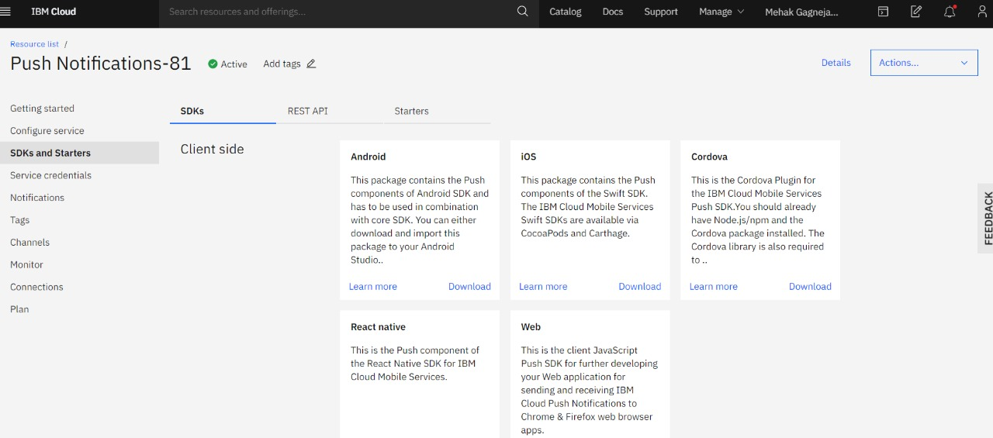

Slide 13
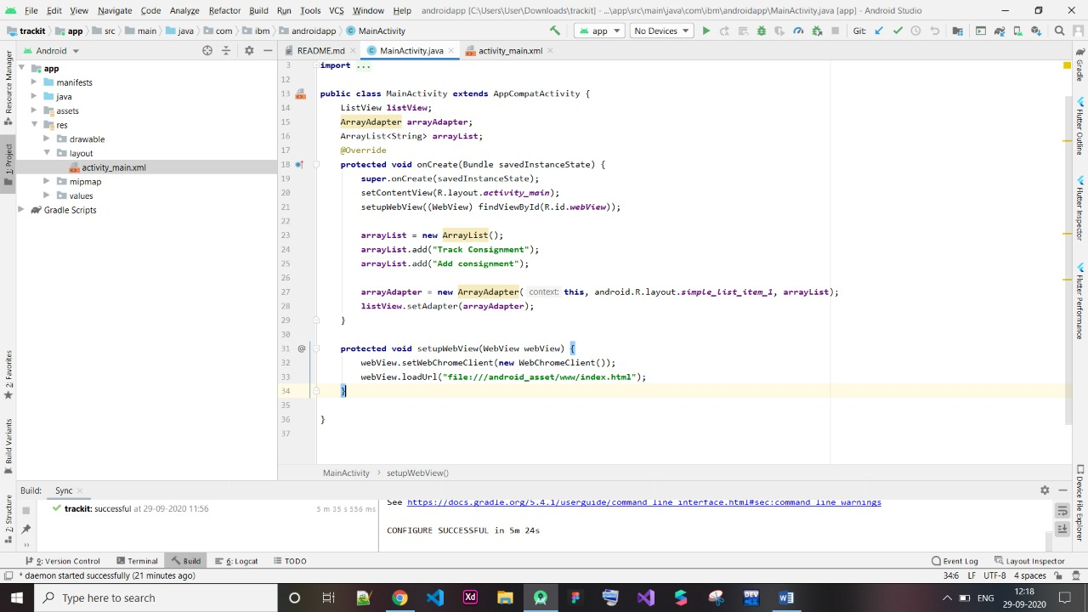
Working With Adapters
In Android, Adapter is a bridge between UI component and data source that helps us to fill data in UI component. It holds the data and send the data to an Adapter view then view can takes the data from the adapter view and shows the data on different views like as ListView, GridView, Spinner etc.

Slide 14
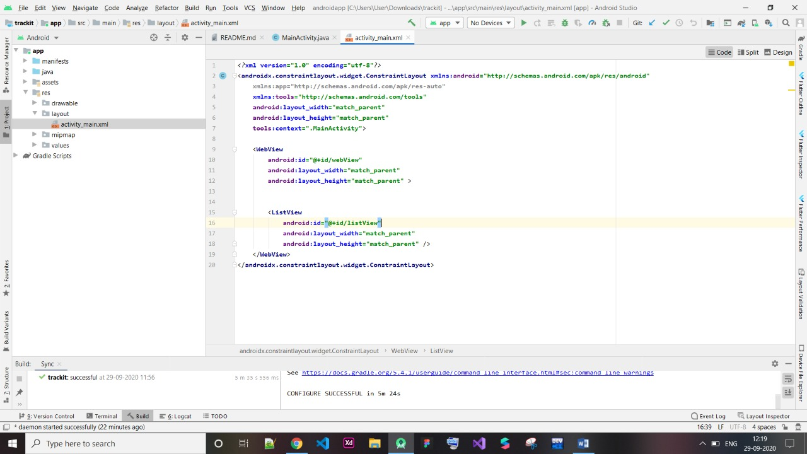

Slide 15

Administering and Testing for Credentials Validation towards User authentication.
In our project Track-IT. We have used OTP based authentication.
The user has to firstly verify his phone number, which is the primary key of our users, a unique id. This is done to make the application secure so that unwanted users are not able to access the application.
Steps:
Implement the FireBaseAuth API
Go to cloud console in Firebase and enable authentication through phone.
Write code for Authentication in your Android Studio.
Authentication completed (OTP Based).

Slide 16
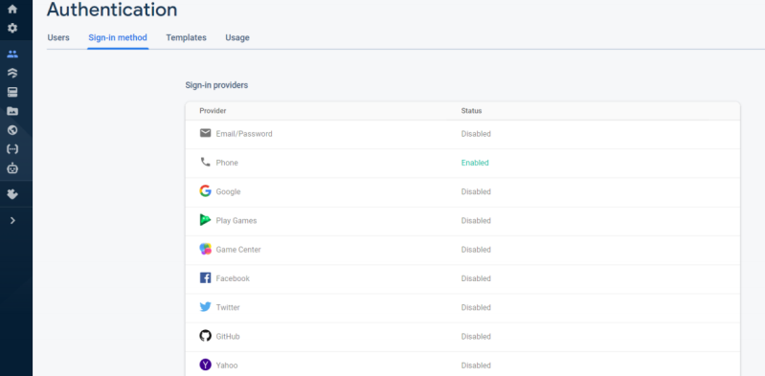
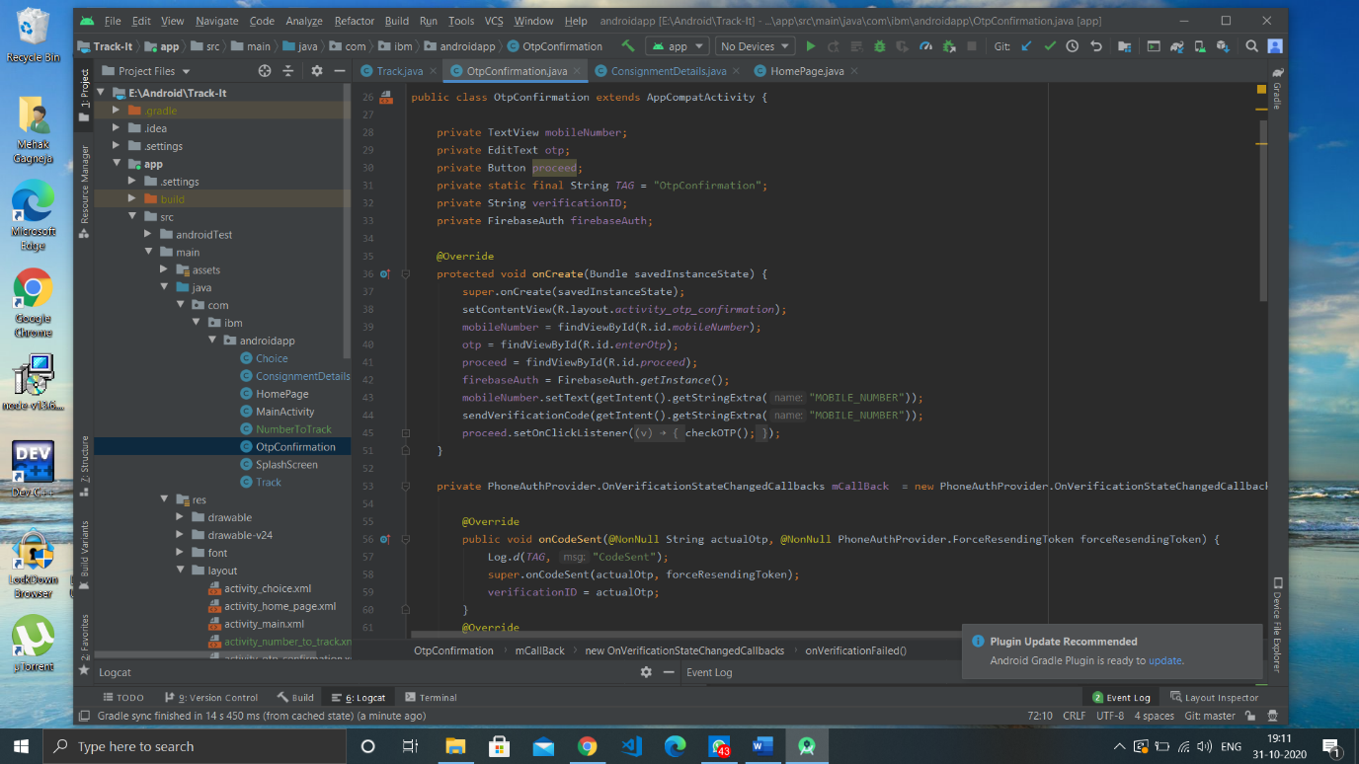

Slide 17
Limitations/Conclusion
Limitations:-
Internet Connectivity is must
Since we are using a basic plan of firebase database so there can be a delay of few seconds in retrieving the data.
Conclusion:-
The application fulfils the purpose of tracking user’s consignment details. Actually, it allows the user to both, add the consignments as well as retrieve its details, such as, driver name, number, client name, client number, vehicle number etc. Also, it has a QR Code scanner, so that one can scan the QR Code of their consignment number provided to track the same. Real-Time location of the consignment can also be tracked.

Slide 18
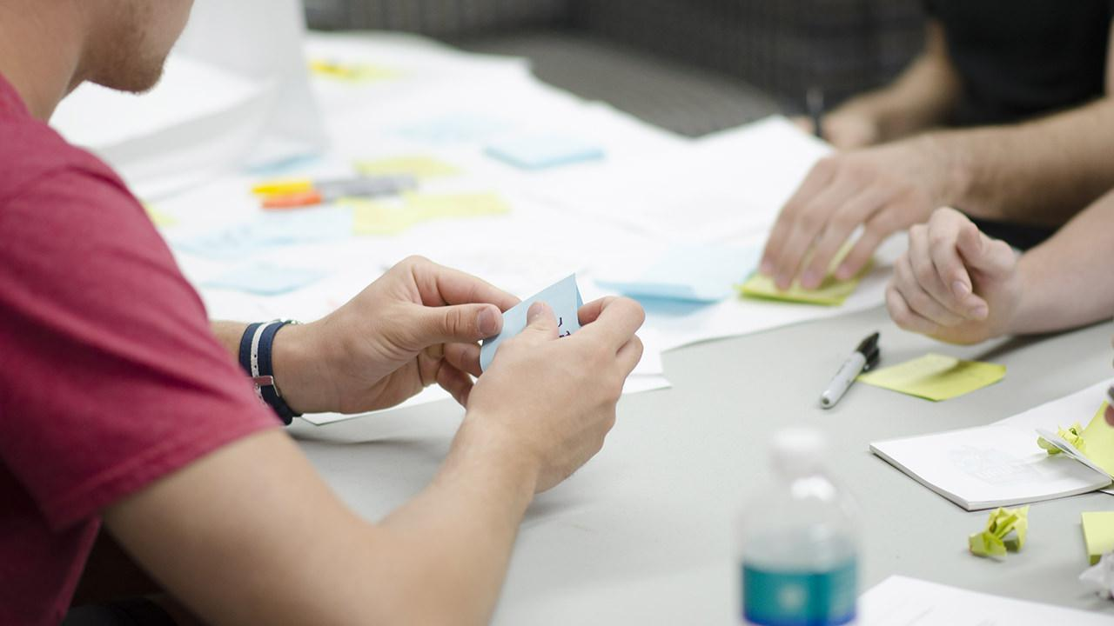
Future enhancements
Integrated money transfer system so that customer don't have to use third party applications
Live tracking system
Integrated chat app which will help the users to chat.
Faster delivery system. same day delivery if destination is within 600kamounts of data quickly.

